Slide 2
Workshop 1
Introduction & Course Concept
Aachen, July 3, 2024
Lennart Reiher, M.Sc.

Slide 3


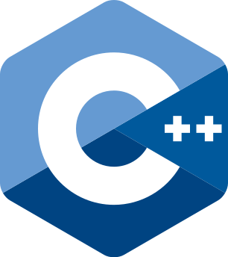


Course Summary
Goal
Frame transition from abstract model-based programming of complex ADAS software features to embedded C++ based implementation

Slide 4



Course Summary
Goal
Frame transition from abstract model-based programming of complex ADAS software features to embedded C++ based implementation
Audience
Background in model-based programming (e.g., MATLAB Simulink)
Basic C++ knowledge expected (Udemy online course to be recapped)
Structure
10 workshop days à 4 hours
Starting with 2 workshops with local presence
7 top-level course sections
Concept
Lectures combined with practical exercises
Live demonstrations and short exercise sessions integrated into workshops
“Homework” exercises for gaining implementation expertise
Learning by gradually building a sample application
First iteration: flexible, not all workshops finalized yet, feedback wanted

Slide 5
Course Agenda
 | Introduction & Course Concept | Workshop 1 (today)
1 | Development Environment & IDE | Workshop 1 (today)
2 | Recap: C++ Syntax & Language Elements | Workshop 2 (04.07.2024)
3 | Software Design & Patterns | Workshops 3, 4
4 | Modern C++ Concepts | Workshops 5, 6
5 | Embedded Software | Workshop 7
6 | Efficient Software Development & Best Practices | Workshops 8, 9
7 | Testing & Code Quality | Workshops 9, 10
 | Wrap-Up & Conclusion | Workshop 10

Slide 6
Didactic Concept: Learn by building
7
Testing & Code Quality
6
Efficient Software Development & Best Practices
5
Embedded Software
4
Modern C++ Concepts
Sample Application
3
Software Design & Patterns
2
C++ Syntax & Language Elements
1
Development Environment & IDE

Slide 7
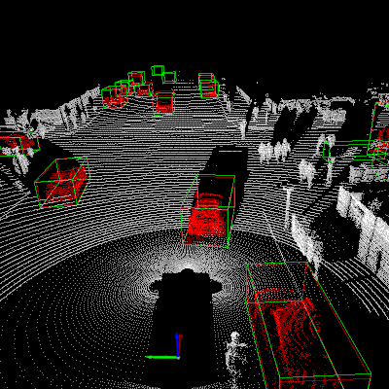

Sample Application: Lidar Object Detection
ADAS-related, yet probably unfamiliar
Closer to automated driving (AD) than advanced driver assistance systems (ADAS)
More focus on C++ implementation, less focus on the function itself
Source
Sample Application
3D points detected by lidar sensor
3D bounding boxes enclosing detected objects

Slide 8
Course Exercises
Live Demos
Lecturer switching from presentation slides to live demo
Focus on following along, no need to reproduce demo in that moment
In-workshop Exercises
Work on your own device, team work encouraged
Limited time
Lecturer available for questions
Quick presentation of solution afterwards
Deep-dive Exercises
Larger software engineering and implementation efforts
Reference solutions made available afterwards
Support available via Learning Space Community Forum
D E M O
Creating and running a Hello World program
E X E R C I S E | 15min
01_Getting-Started.ipynb
H O M E W O R K
Checking your development environment

Slide 9
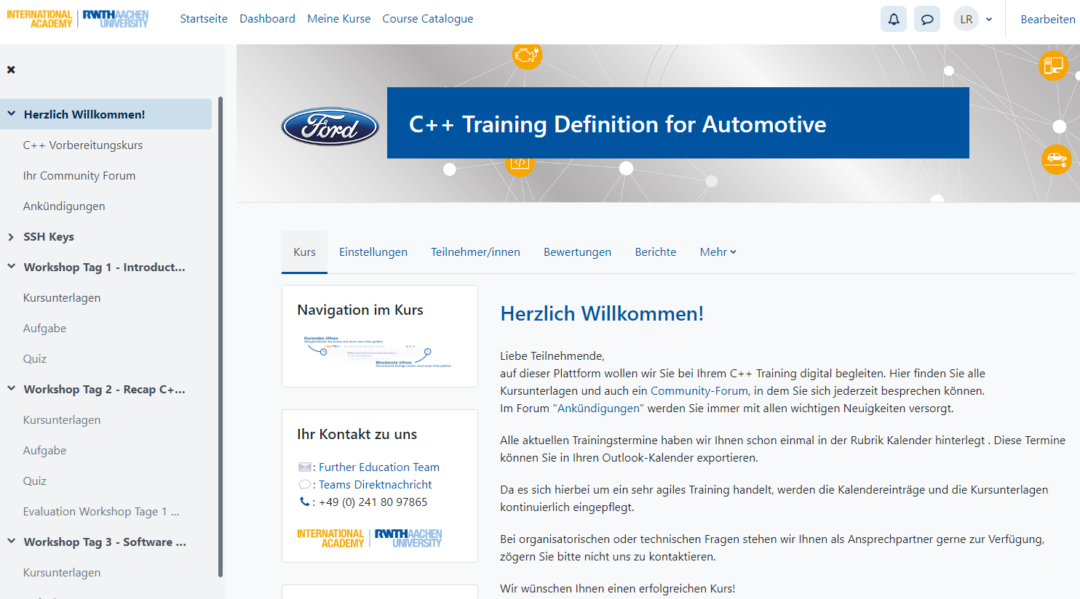

Learning Space
Default communication channel for course
Distribution of workshop material, incl. slides (available before each workshop)
Community forum for questions, problems, feedback etc.
Credentials to learning space were distributed via mail on June 6
https://learningspace.academy.rwth-aachen.de/course/view.php?id=415

Slide 10


Let’s shape this course together!
Feel free to raise questions at any time
Actively collaborate with your colleagues during the in-workshop exercises
Give honest and constructive feedback at the end of each workshop
Any questions at this point?

Slide 11
Agenda for Workshop 1
 | Introduction & Course Concept | 09:00 – now
1 | Development Environment & IDE | now – 14:00
 | Q & A and Feedback | interactively during workshop
 | Breaks & Lunch Break | on demand

Slide 12
Workshop 1
1 | Development Environment & IDE
Aachen, July 3, 2024
Lennart Reiher, M.Sc.

Slide 13
Learning Objectives
Get to know the development environments of the course
Gain background knowledge about containerization and remote development
Get started with C++ development in Visual Studio Code
Know details about the compilation process
Learn about C++’s history and relevance

Slide 14
C++ Background
What‘s needed?
Working with JupyterHub
Working with Visual Studio Code – Remote Containers
Step-by-Step Compilation
Working with Visual Studio Code – Extensions, Tasks, Debugging
Wrap-up

Slide 15

C++ Background
What is C++?
C++ is a high-level general-purpose programming language created in the early 1980s by Bjarne Stroustrup as an extension of the C language
#include <iostream>
int main() {
std::cout << "Hello World!" << std::endl;
return 0;
}
“Hello World!”

Slide 16
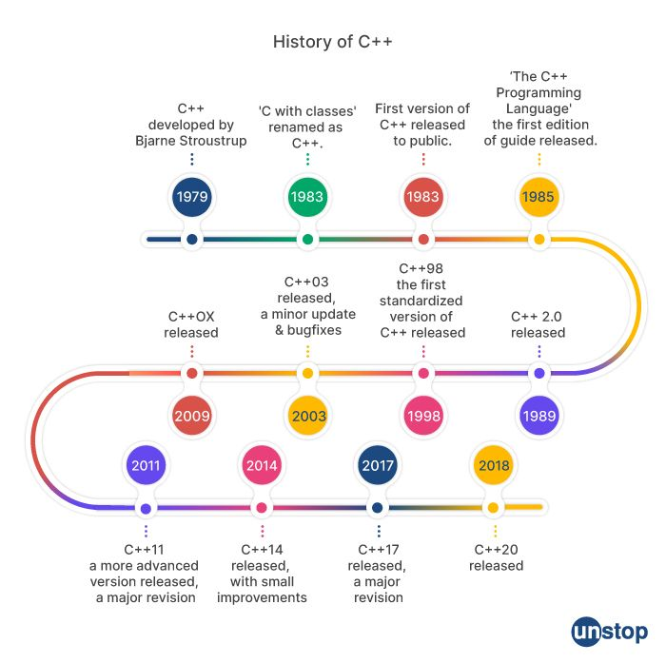
C++ Background
History of C++
Purpose
Designed to provide features known from other languages at the time to the C programming language
Key Milestones
C with Classes | initial version with support for classes and inheritance (object orientation)
C++98 | first standardized version, introducing features like template programming and the Standard Template Library (STL)
Modern C++ | Significant language updates with C++11, starting a new standard release every three years
Source

Slide 17
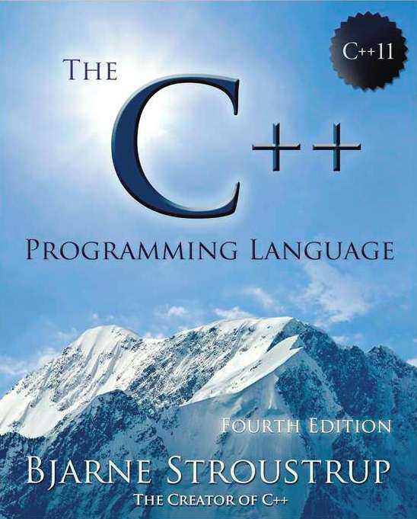

C++ Background
Standardization
The C++ Programming Language
First book to describe C++, written by Stroustrup himself
First edition released in 1985, current fourth edition describing C++11
Used to be the definitive reference for the language
Source
Official Standardization
C++98 first version to be standardized by ISO: ISO/IEC 14882
Standard managed by the ISO C++ committee WG21
Open to contribution by anyone
Multiple major implementations of standard exist: GCC, Clang/LLVM, etc.

Slide 18
C++ Background
Programming Paradigms: C++ is …
Procedural
Perform a task through a sequence of instructions
Use functions to encapsulate code and promote reusability
Object-oriented
Organize code into classes and objects of those that contain data and functions
Support inheritance and polymorphism
Imperative
Change program state through statements
Control program flow with loops, conditionals, etc.
Generic
Use templates to write code that works with any data type
Functional
Construct programs by applying and composing functions
Treat functions as first-class citizens that can be passed to and returned from functions
Modular
Separate program functionality into independent, interchangeable modules

Slide 19



C++ Background
Why C++ for ADAS?
Performance & Efficiency
Optimized for speed and resource efficiency
Low-level access for direct manipulation of hardware and memory
Robustness & Reliability
Strong type checking and many more features for robust code
Battle-tested through a long history of use in critical systems
Flexibility & Portability
General-purpose, let’s you do basically anything
Suitable from microcontroller systems to large-scale distributed systems

Slide 20
C++ Background
Comparison to Other Programming Languages
C
Prototype for C++, almost same syntax
No object orientation, no standard template library, …
As low-level as high-level programming languages get
Considered to be a foundational programming language used for developing low-level systems such as compilers or operating systems
Python
Not a compiled language, but interpreted at runtime
Runtime implemented in C
Dynamic typing as opposed to static type checking at compile time
Known for its simplicity and rich ecosystem, especially for data analysis and machine learning
Rust
Relatively young (2015), but increasingly popular language
Designed to be an alternative to C++
Focus on memory safety and concurrency to increase robustness
Efficiency
Low-level control
Ease of Use
Versatility
Performance
Reliability

Slide 21

C++ Background
Learning C++ vs Learning Other Languages
C
Python
Rust
Efficiency
Low-level control
Ease of Use
Versatility
Performance
Reliability
C++ is general-purpose, most of the concepts, ideas, pitfalls translate well to other languages – in general, experience with C++ is valuable in many industries

Slide 22
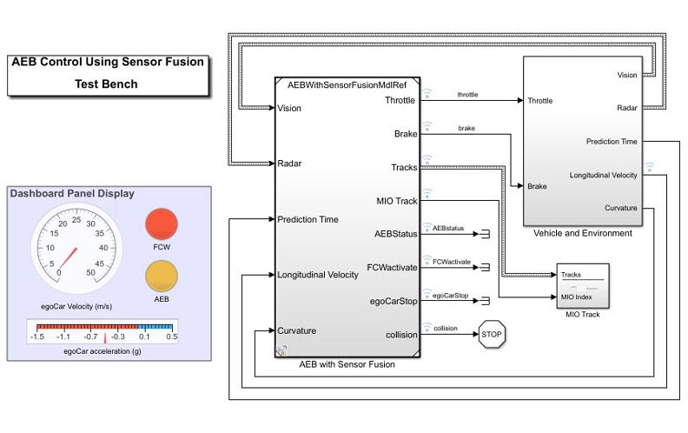

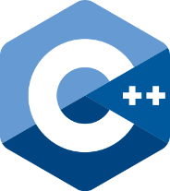
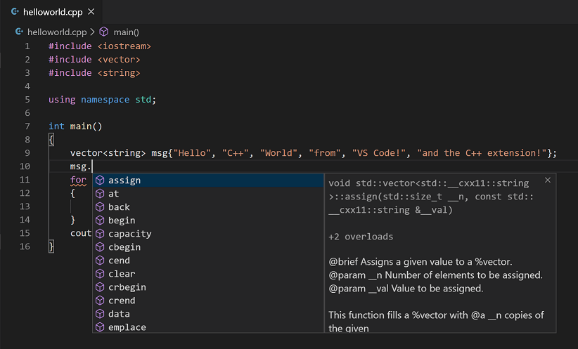
C++ Background
Comparison to Model-Based Programming (MBD)
Graphical programming vs text-based programming
Intuitive graphical presentation vs complex syntax
Focus on high-level system design vs fine-grained control
Abstraction of low-level details vs maximum flexibility
Integrated simulation and testing vs traditional debugging
Code generation based on templates vs code-level optimizability
(Often) bound to commercial products vs free implementation
Source
Source

Slide 23
C++ Background
What‘s needed?
Working with JupyterHub
Working with Visual Studio Code – Remote Containers
Step-by-Step Compilation
Working with Visual Studio Code – Extensions, Tasks, Debugging
Wrap-up

Slide 24


What’s needed?
What do I need to program C++?
Text Editor
Typing the C++ program code
Compiler
Translating C++ code to a machine-executable binary
D E M O
Hello World
01_hello-world

Slide 25

What’s needed?
What can I use to program C++?
Is this just a text editor?

Slide 26





What’s needed?
What can I use to program C++?
Terminal
Editor
Documentation
Productivity
Version Control
Build Systems
…
Refactoring
Debugging
GUI
Compilation
Automation
Profiling
Linting
Integrated Development Environment
“An integrated development environment (IDE) is a software application that provides comprehensive facilities for software development. An IDE normally consists of at least a source-code editor, build automation tools, and a debugger.” ¹
Examples
Visual Studio
Visual Studio Code
CLion
XCode
QtCreator
1 Source

Slide 27
What’s needed?
It’s all just a tool!
Terminal
Editor
Documentation
Productivity
Version Control
Build Systems
…
Refactoring
Debugging
GUI
Compilation
Automation
Profiling
Linting
Text Editor
Typing the C++ program code
Integrated Development Environment
“An integrated development environment (IDE) is a software application that provides comprehensive facilities for software development. An IDE normally consists of at least a source-code editor, build automation tools, and a debugger.” ¹
Compiler
Translating C++ code to a machine-executable binary
Examples
Visual Studio
Visual Studio Code
CLion
XCode
QtCreator
1 Source

Slide 28


What’s needed?
What are we going to use to program C++ in this course?
Visual Studio Code
JupyterHub
Installed on your computers
Remotely connected to ika development server to ensure consistent development environments
To be used for application development exercises
Accessible via any web browser
Python-like instant execution of C++ code in a so-called Jupyter notebook
To be used for simple syntax exercises

Slide 29
What’s needed?
Checklist for Participation
Windows, Mac, or Linux computer
Internet connection (in Germany)
Installed apps
Any internet browser
Visual Studio Code (Download)
Distributed via mail / learning space in advance
Username and password for accessing JupyterHub (e.g., “ext-i-reiher”)
SSH keys for accessing development server (two files, e.g., “ext-i-reiher” and “ext-i-reiher.pub”)

Slide 30
C++ Background
What‘s needed?
Working with JupyterHub
Working with Visual Studio Code – Remote Containers
Step-by-Step Compilation
Working with Visual Studio Code – Extensions, Tasks, Debugging
Wrap-up

Slide 31
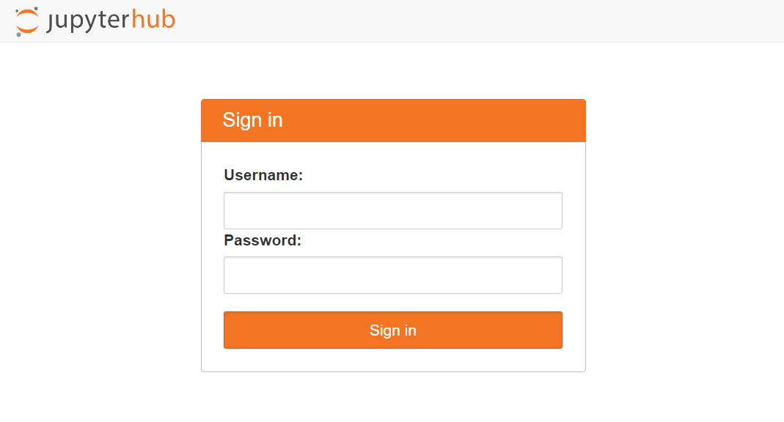

Working with JupyterHub
Accessing JupyterHub
Credentials were distributed via learning space in advance
https://academylab.ika.rwth-aachen.de/
D E M O
JupyterHub
02_jupyterhub

Slide 32
Working with JupyterHub
Exercise
E X E R C I S E | 15min
https://academylab.ika.rwth-aachen.de/
01_Getting-Started.ipynb

Slide 33
C++ Background
What‘s needed?
Working with JupyterHub
Working with Visual Studio Code – Remote Containers
Step-by-Step Compilation
Working with Visual Studio Code – Extensions, Tasks, Debugging
Wrap-up

Slide 34

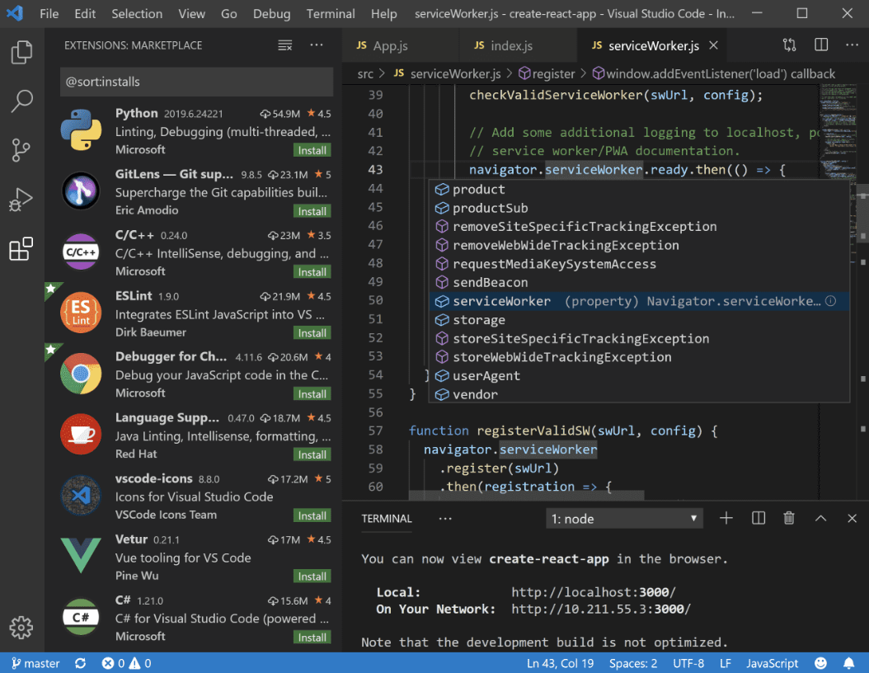
Working with Visual Studio Code – Remote Containers
What is VS Code?
General purpose IDE, not focused on one particular programming language
Cross-platform, free, open source
Built-in generalized IDE features
Syntax highlighting
Intelligent autocompletion
Terminal and logging
Git version control
Running and debugging
Highly customizable through extensions
Programming languages
Productivity tools
Themes
First released in 2015, has quickly risen to the most popular IDE in the world, used by 74% of all developers¹
1 Source

Slide 35



Working with Visual Studio Code – Remote Containers
Why VS Code for this course?
Popularity
Does that mean that you have to continue using VS Code?
Most definitely no! The concepts taught will also transfer to other IDEs. Remember, it’s just a tool!
Flexibility
Remote Development

Slide 36

Working with Visual Studio Code – Remote Containers
Environment Consistency
Programming is complex, involving many different tools with many different versions
Having a consistent development environment is key to ensure reproducibility
Reproducibility should hold across machines and across developers
How can we ensure that all code developed by you in this course will always behave exactly the same, although all of you will be working on your own computers?
At the same time, how can we simplify setting up the development environment as much as possible to prevent too much installation headache?
Both concepts are independent of C++
Containerization
Remote Development

Slide 37
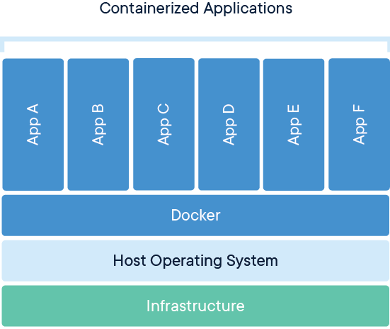
Working with Visual Studio Code – Remote Containers
Containerization
“A container is a standard unit of software that packages up code and all its dependencies so the application runs quickly and reliably from one computing environment to another. A […] container image is a lightweight, standalone, executable package of software that includes everything needed to run an application: code, runtime, system tools, system libraries and settings.” ¹
Source
1 Source

Slide 38
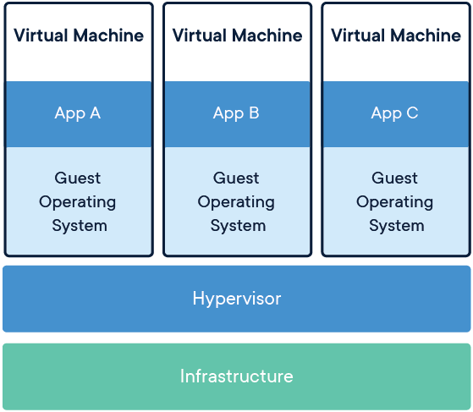
Working with Visual Studio Code – Remote Containers
Containers vs Virtual Machines
Source
Source

Slide 39

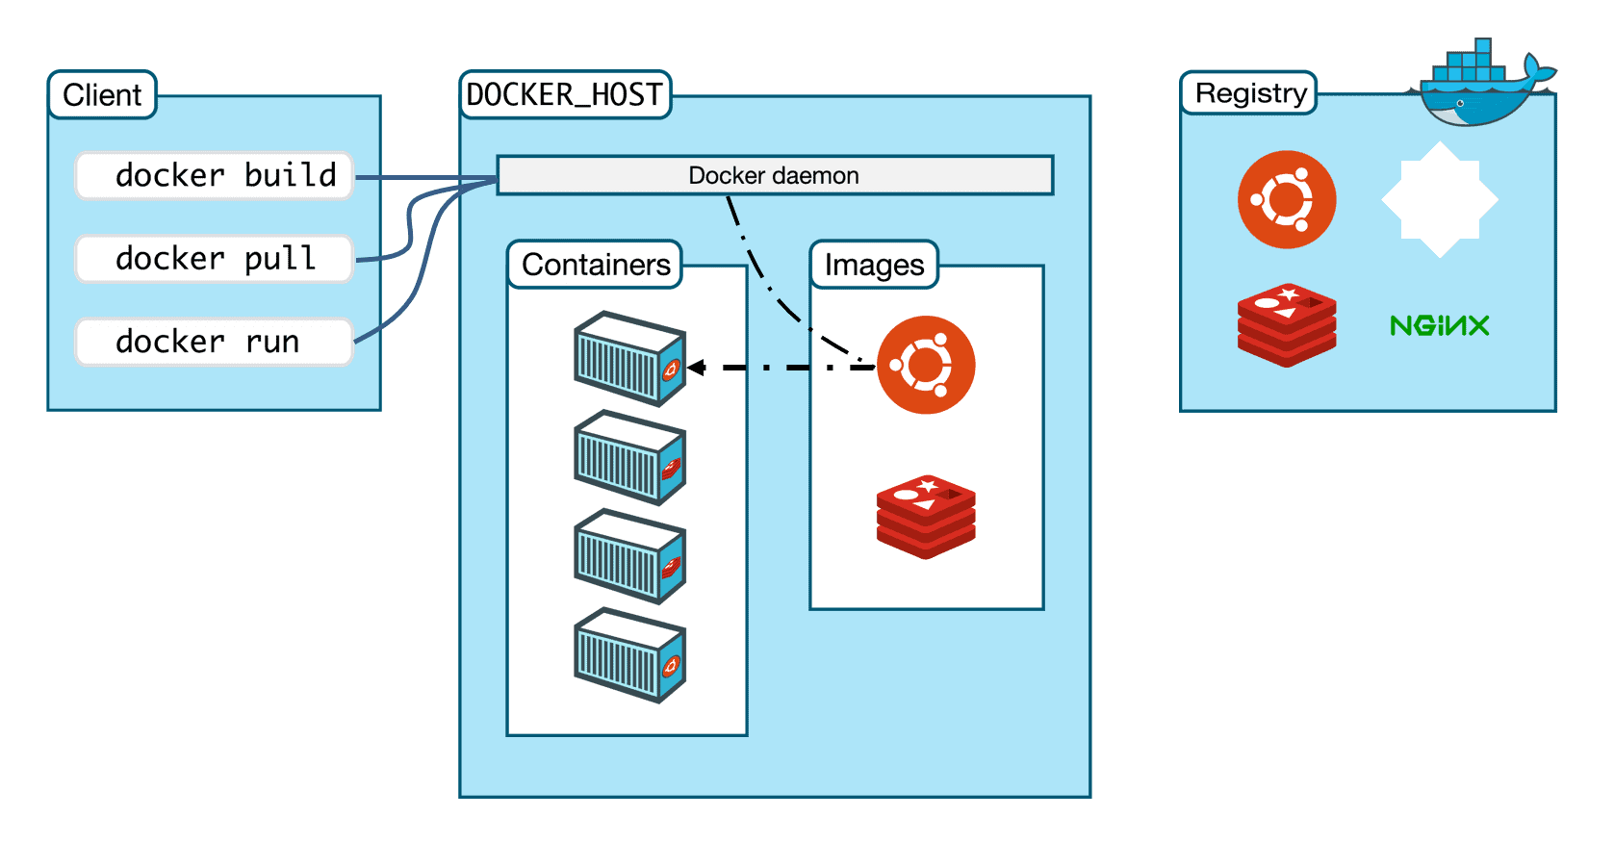
Working with Visual Studio Code – Remote Containers
Containers with Docker
For many, containerization is synonymous with using Docker
Other container runtimes exist, e.g., Podman or CRI-O
(optional) Getting Started with Docker
Source
D E M O
Docker Basics
03_docker-basics

Slide 40
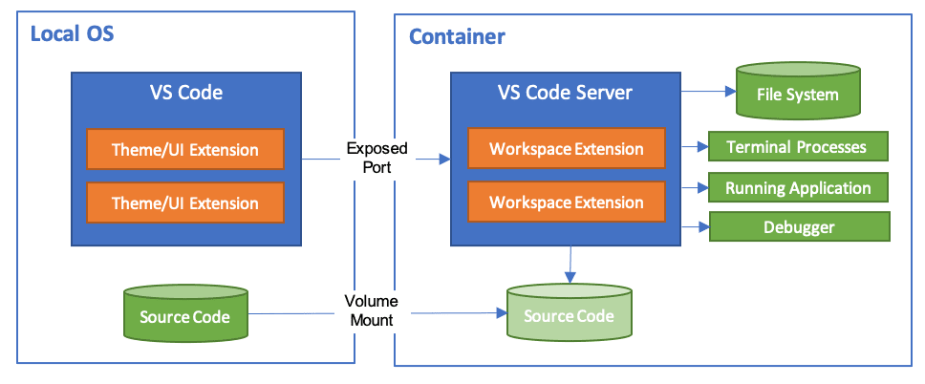
Working with Visual Studio Code – Remote Containers
Dev Containers in VS Code
VS Code Dev Containers extension offers using a container as a full-featured development environment
Native VS Code experience coupled with consistent and reproducible container environment
Solves the classic dilemma of “but it runs on my system”
(optional) Developing inside a Container
D E M O
Dev Containers
04_dev-containers

Slide 41
Working with Visual Studio Code – Remote Containers
Remote Development in Containers
How can we ensure that all code developed by you in this course will always behave exactly the same, although all of you will be working on your own computers?
At the same time, how can we simplify setting up the development environment as much as possible to prevent too much installation headache?
Containerization
Remote Development
We are developing in containers within this course
We are developing remotely within this course, requiring only VS Code on participants’ computers
We are not bothering with Docker directly (and bypassing security concerns in the process¹)
Instead, we are attaching VS Code to a development container running on a remote server
1 Source

Slide 42



Working with Visual Studio Code – Remote Containers
Development Environment in this Course
Development Container for User 1
Port 22
Port 2222
Port 22
Proxy Container
Development Container for User 2
Your Computer
Our Server
Port 22
Development Container for User N
Port 22
Container-based reproducible development environment
Secure access via SSH key authentication
No access to host server or Docker privileges required

Slide 43
Working with Visual Studio Code – Remote Containers
Development Environment in this Course (simplified)
Development Container
Your Computer
Our Server
Knowledge of inner workings not required for this course, but helpful to keep containerization and remote development in mind as useful tools
D E M O
Accessing Remote Dev Container
Instructions on following slides

Slide 44
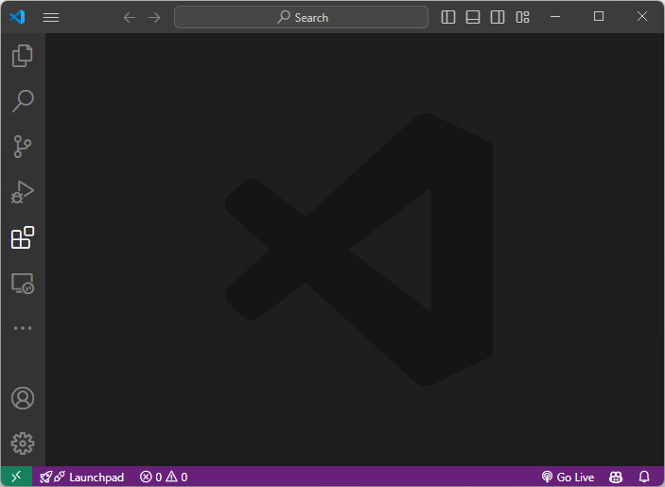
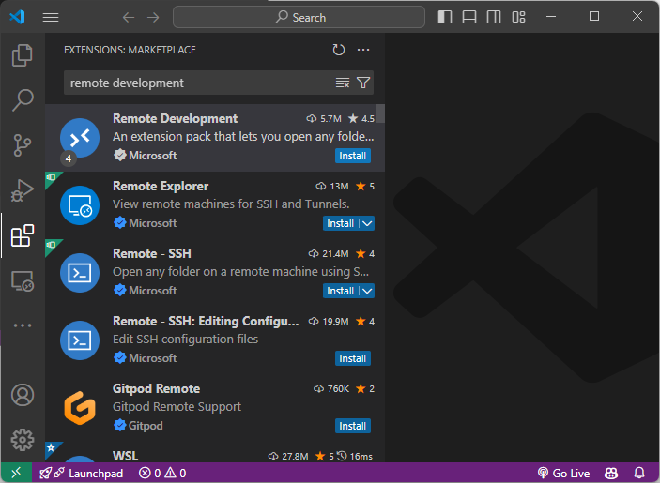

Working with Visual Studio Code – Remote Containers
Accessing Development Containers in VS Code (1/5)
2
3
1

Slide 45
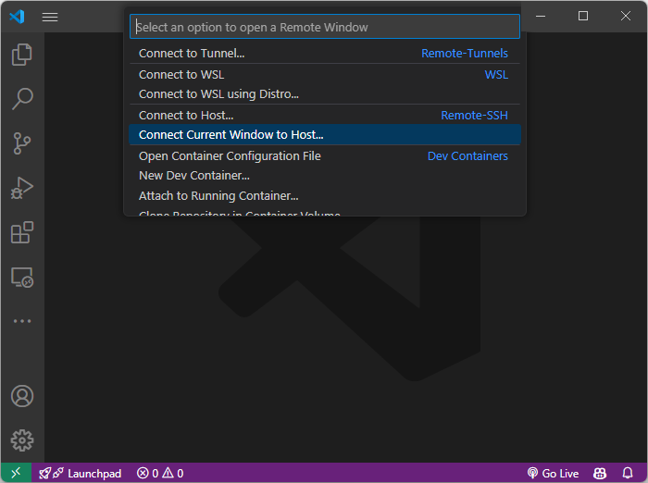
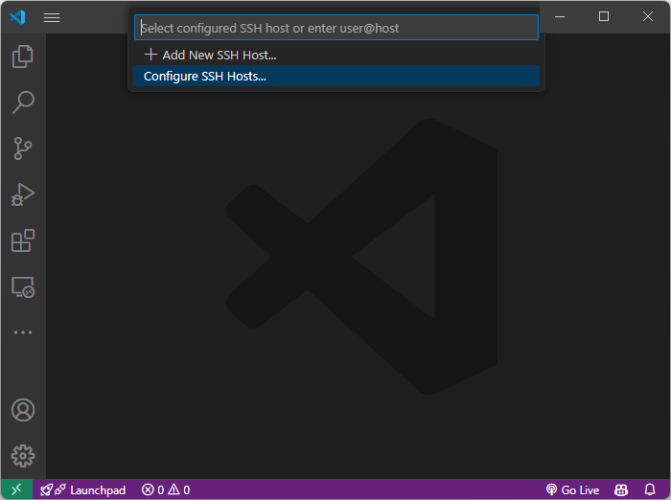
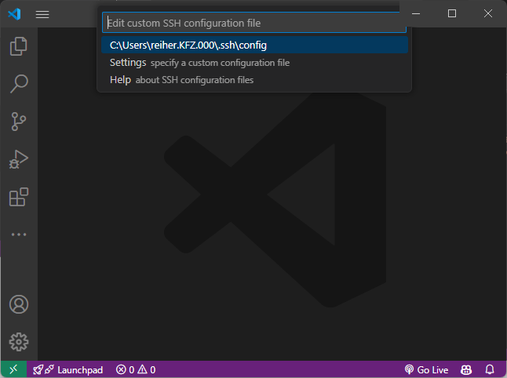
Working with Visual Studio Code – Remote Containers
Accessing Development Containers in VS Code (2/5)
6
7
5
4

Slide 46
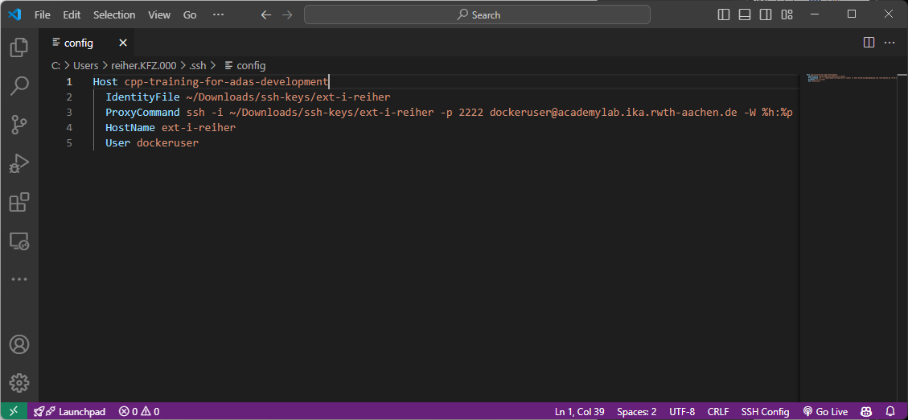
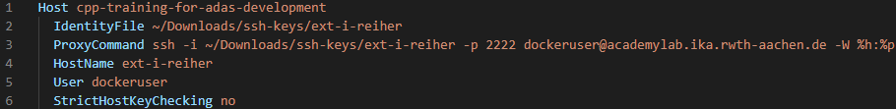
Working with Visual Studio Code – Remote Containers
Accessing Development Containers in VS Code (3/5)
8
Unix-like path to your private key; ~ is equivalent to /c:/Users/<USER> even on Windows
your username

Slide 47
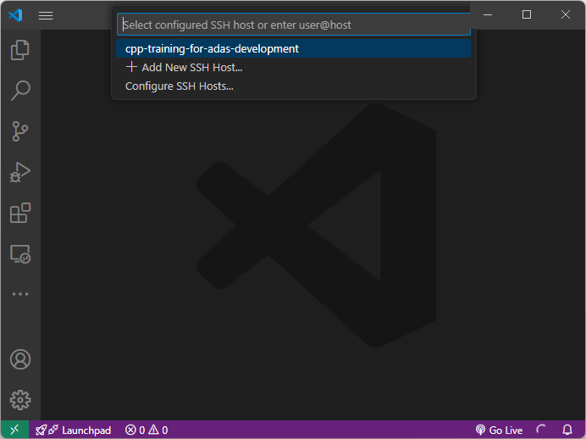
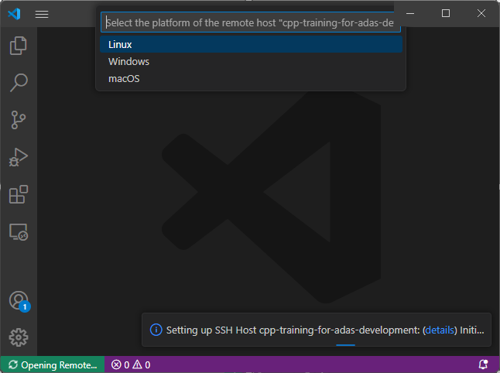
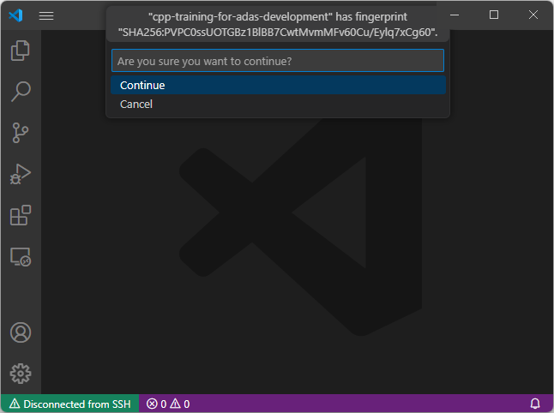
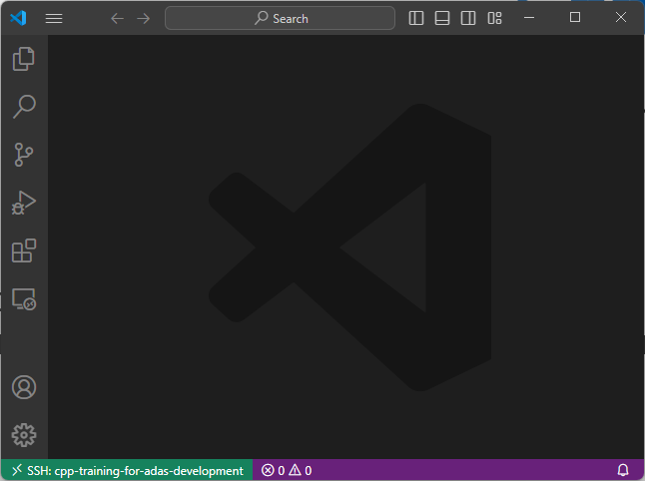

Working with Visual Studio Code – Remote Containers
Accessing Development Containers in VS Code (4/5)
11
10
12
9
13
14

Slide 48

Working with Visual Studio Code – Remote Containers
Demo & Exercise Git Repository
Instructions and source code for demos, exercises, and homework are stored in a Git repository
Repository is already cloned in development containers at /home/dockeruser/cpp-for-adas
You may freely work and commit in this local repository
Basic Git skills are assumed; reach out to us if help is needed or you would like to learn more
It is encouraged to work on your own branch: git checkout –b <USERNAME>
You may push your branch to the Git remote to share with others: git push
As we will be adding materials to the main branch, you will have to pull those into your branch
git fetch && git merge origin/main
We will let you know if necessary

Slide 49
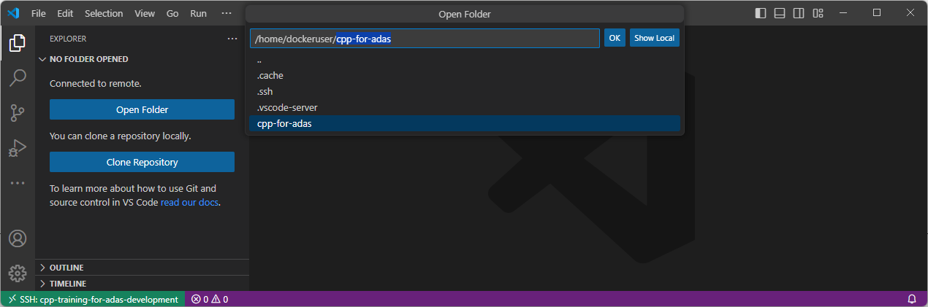
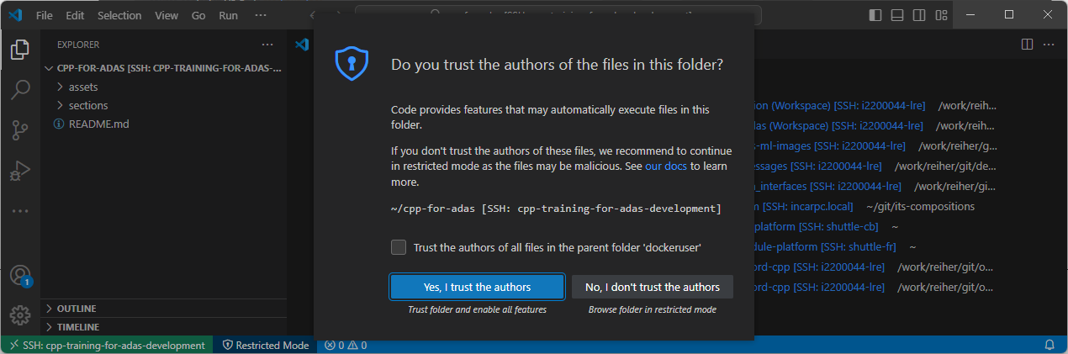
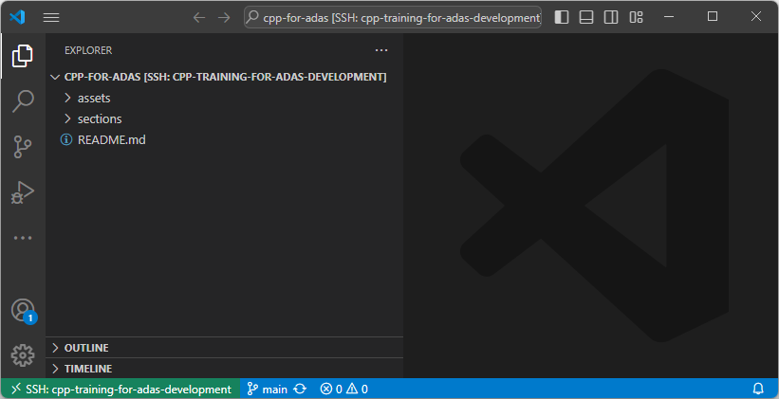
Working with Visual Studio Code – Remote Containers
Accessing Development Containers in VS Code (5/5)
15
18
7
16
17
19
Container image is based on Linux Ubuntu
Container username is dockeruser
User password is dockeruser
User is allowed to run sudo in container
20

Slide 50
Working with Visual Studio Code – Remote Containers
Accessing Development Containers in VS Code – Troubleshooting
Problem
VS Code asking for password when connecting to remote development container
Explanation
SSH key authentication is failing
May be debugged by running SSH manually in verbose mode
ssh –vvv cpp-training-for-adas-development
Most likely cause: permissions for private key are too open, i.e., other users on your computer could potentially misuse your private key
SSH warns about this, decides to ignore the private key, and falls back to password
Solution
Fix the file permissions for your private key, s.t. only your user can read/write it
On Linux/Mac, run the following in a terminal
chmod 600 <PATH/TO/YOUR/PRIVATE/KEY>
On Windows, follow these instructions

Slide 51
Working with Visual Studio Code – Remote Containers
Exercise
E X E R C I S E | 20min
Connect VS Code on your computer to your development container on our server
Open the repository in VS Code
Open a terminal and check the compiler version: clang --version
Slides available in learning space

Slide 52
C++ Background
What‘s needed?
Working with JupyterHub
Working with Visual Studio Code – Remote Containers
Step-by-Step Compilation
Working with Visual Studio Code – Extensions, Tasks, Debugging
Wrap-up

Slide 53
Step-by-Step Compilation
Standards and Compilers
To be used in this course
C++ standard defines how the programming language is supposed to function
Example: an int is guaranteed to be at least 16 bits wide¹
Guaranteed range: -32768 to 32767
But most 32/64bit platforms implement it as 32bit anyway
Overview of standards²
C++98: first standard, basic C++ features
C++03: minor bug fixes and improvements
C++11: major update with features like auto type deduction, lambda expressions, smart pointers
C++14: small enhancements and bug fixes
C++17: new features like filesystem library, std::optional, std::variant
C++20: new features like concepts, coroutines
C++23: even more new features/improvements
C++ compilers implement the rules defined by the standard and perform the compilation process
Code written to a specific C++ standard can be compiled by any compliant compiler
Compilers vary in, e.g., standard support, platform support, code optimization, and diagnostics
Overview of compilers
GCC (GNU Compiler Collection)
Widely used, multi-platform and -language support, open-source
Clang/LLVM
Widely used, multi-platform and -language support, open-source
Clang is compiler frontend for C-like languages built on the LLVM compiler backend for any language
MSVC (Microsoft Visual C++)
Primarily targeted at Windows development
Fun question: what programming languages are the compilers written in?
1 Source 2 Source

Slide 54
Step-by-Step Compilation
Step-by-Step Compilation with Clang
#include <iostream>
int main() {
std::cout << "Hello World!" << std::endl;
return 0;
}
“Hello World!”
D E M O
Step-by-Step Compilation
05_step-by-step-compilation

Slide 55
Step-by-Step Compilation
Step-by-Step Compilation with Clang
# | Name | Command | Description
1 | Preprocessing | clang++ –E hello.cpp –o hello.i | Expands macros and included header files
2 | Compilation | clang++ –S hello.i –o hello.s | Translates high-level C++ code to low-level, platform-dependent, but still human-readable assembly instructions
3 | Assembly | clang++ –c hello.s –o hello.o | Produces binary machine code; not yet executable
4 | Linking | clang++ hello.o –o hello | Combines object file with necessary libraries and resolves symbol references; produces final executable
5 | Execution | ./hello | Runs the program
1-4 | „Compilation“ | clang++ hello.cpp –o hello | Combines all compilation steps into one single command

Slide 56
Step-by-Step Compilation
Step-by-Step Compilation with Clang – Preprocessing (1/5)
# | Name | Command | Description
1 | Preprocessing | clang++ –E hello.cpp –o hello.i | Expands macros and included header files
# 1 "hello.cpp"
# 1 "<built-in>" 1
# 1 "<built-in>" 3
# 404 "<built-in>" 3
# 1 "<command line>" 1
# 1 "<built-in>" 2
# 1 "hello.cpp" 2
# 1 "/usr/bin/../lib/gcc/x86_64-linux-gnu/11/../../../../include/c++/11/iostream" 1 3
# 37 "/usr/bin/../lib/gcc/x86_64-linux-gnu/11/../../../../include/c++/11/iostream" 3
# 1 "/usr/bin/../lib/gcc/x86_64-linux-gnu/11/../../../../include/x86_64-linux-gnu/c++/11/bits/c++config.h" 1 3
# 278 "/usr/bin/../lib/gcc/x86_64-linux-gnu/11/../../../../include/x86_64-linux-gnu/c++/11/bits/c++config.h" 3
namespace std
{
typedef long unsigned int size_t;
typedef long int ptrdiff_t;
// plus 30.000+ more lines
#include <iostream>
int main() {
std::cout << "Hello World!" << std::endl;
return 0;
}

Slide 57
Step-by-Step Compilation
Step-by-Step Compilation with Clang – Compilation (2/5)
# | Name | Command | Description
2 | Compilation | clang++ –S hello.i –o hello.s | Translates high-level C++ code to low-level, platform-dependent, but still human-readable assembly instructions
# 1 "hello.cpp"
# 1 "<built-in>" 1
# 1 "<built-in>" 3
# 404 "<built-in>" 3
# 1 "<command line>" 1
# 1 "<built-in>" 2
# 1 "hello.cpp" 2
# 1 "/usr/bin/../lib/gcc/x86_64-linux-gnu/11/../../../../include/c++/11/iostream" 1 3
# 37 "/usr/bin/../lib/gcc/x86_64-linux-gnu/11/../../../../include/c++/11/iostream" 3
# 1 "/usr/bin/../lib/gcc/x86_64-linux-gnu/11/../../../../include/x86_64-linux-gnu/c++/11/bits/c++config.h" 1 3
# 278 "/usr/bin/../lib/gcc/x86_64-linux-gnu/11/../../../../include/x86_64-linux-gnu/c++/11/bits/c++config.h" 3
namespace std
{
typedef long unsigned int size_t;
typedef long int ptrdiff_t;
// plus 30.000+ more lines
.text
.file "hello.cpp"
.section .text.startup,"ax",@progbits
.p2align 4, 0x90 # -- Begin function __cxx_global_var_init
.type __cxx_global_var_init,@function
__cxx_global_var_init: # @__cxx_global_var_init
.cfi_startproc
# %bb.0:
pushq %rbp
.cfi_def_cfa_offset 16
.cfi_offset %rbp, -16
movq %rsp, %rbp
.cfi_def_cfa_register %rbp
leaq _ZStL8__ioinit(%rip), %rdi
callq _ZNSt8ios_base4InitC1Ev@PLT
movq _ZNSt8ios_base4InitD1Ev@GOTPCREL(%rip), %rdi
leaq _ZStL8__ioinit(%rip), %rsi
leaq __dso_handle(%rip), %rdx
// 100 lines in total

Slide 58

Step-by-Step Compilation
Step-by-Step Compilation with Clang – Assembly (3/5)
# | Name | Command | Description
3 | Assembly | clang++ –c hello.s –o hello.o | Produces binary machine code; not yet executable
.text
.file "hello.cpp"
.section .text.startup,"ax",@progbits
.p2align 4, 0x90 # -- Begin function __cxx_global_var_init
.type __cxx_global_var_init,@function
__cxx_global_var_init: # @__cxx_global_var_init
.cfi_startproc
# %bb.0:
pushq %rbp
.cfi_def_cfa_offset 16
.cfi_offset %rbp, -16
movq %rsp, %rbp
.cfi_def_cfa_register %rbp
leaq _ZStL8__ioinit(%rip), %rdi
callq _ZNSt8ios_base4InitC1Ev@PLT
movq _ZNSt8ios_base4InitD1Ev@GOTPCREL(%rip), %rdi
leaq _ZStL8__ioinit(%rip), %rsi
leaq __dso_handle(%rip), %rdx
// 100 lines in total

Slide 59
Step-by-Step Compilation
Step-by-Step Compilation with Clang – Linking (4/5)
# | Name | Command | Description
4 | Linking | clang++ hello.o –o hello | Combines object file with necessary libraries and resolves symbol references; produces final executable

Slide 60
Step-by-Step Compilation
Step-by-Step Compilation with Clang – Execution (5/5)
# | Name | Command | Description
5 | Execution | ./hello | Runs the program
“Hello World!”

Slide 61
Step-by-Step Compilation
Exercise
E X E R C I S E | 15min
01_clang-compiler-errors

Slide 62
C++ Background
What‘s needed?
Working with JupyterHub
Working with Visual Studio Code – Remote Containers
Step-by-Step Compilation
Working with Visual Studio Code – Extensions, Tasks, Debugging
Wrap-up

Slide 63
Working with Visual Studio Code – Extensions, Tasks, Debugging
Extensions
One key selling point of VS Code is its customizability through extensions for practically anything
Languages, debuggers, productivity tools, themes, and more
The repository contains a list of recommended extensions, some of which are strictly necessary
Go to the extensions tab (Ctrl+Shift+X) and search for “@recommended”
Install all workspace recommendations
Recommendations are defined in .vscode/extensions.json
You are free to install any other extension that you might find useful
Reference information about VS Code extensions
D E M O
VS Code Extensions
06_vs-code-extensions

Slide 64
Working with Visual Studio Code – Extensions, Tasks, Debugging
Tasks
VS Code allows to define so-called tasks for natively integrating any external tools
Compiling source files, formatting, running scripts, etc.
Tasks are defined in .vscode/tasks.json
The repository already defines two basic tasks for compiling and running
Default build task (Ctrl+Shift+B): Compile current file with clang++
Default test task (Ctrl+Shift+P / Tasks: Run test task): Run executable of current file
You are free to define any other task that you might find useful
Reference information about VS Code tasks
D E M O
VS Code Tasks
07_vs-code-tasks

Slide 65
Working with Visual Studio Code – Extensions, Tasks, Debugging
Debugging
VS Code has a built-in debugging system driven by debugging extensions for specific languages
Breakpoints, data inspection, debug console, etc.
Debugging configurations are defined in .vscode/launch.json
The repository already defines a basic debugging configuration using the LLVM debugger LLDB on the currently active executable
You are free to define any other debugging configuration that you might find useful
Reference information about VS Code debugging
D E M O
VS Code Debugging
08_vs-code-debugging

Slide 66
Working with Visual Studio Code – Extensions, Tasks, Debugging
IntelliSense and More Editing Features
IntelliSense is a general term for various code editing features
Code completion, parameter info, quick info, etc.
IntelliSense is constantly scanning the entire code base to provide suggestions and information
Next to IntelliSense, the C/C++ extension for VS Code brings more small productivity features
Syntax highlighting, code formatting, go to definition, go to declaration, etc.
Reference information about VS Code IntelliSense
Reference information about editing and navigating C++ code in VS Code
D E M O
VS Code IntelliSense and more
09_vs-code-intellisense-and-more

Slide 67
Working with Visual Studio Code – Extensions, Tasks, Debugging
Exercise
E X E R C I S E | 25min
02_golden-ratio

Slide 68
C++ Background
What‘s needed?
Working with JupyterHub
Working with Visual Studio Code – Remote Containers
Step-by-Step Compilation
Working with Visual Studio Code – Extensions, Tasks, Debugging
Wrap-up

Slide 69
Wrap-up
Learning Objectives
Get to know the development environments of the course
Gain background knowledge about containerization and remote development
Get started with C++ development in Visual Studio Code
Know details about the compilation process
Learn about C++’s history and relevance

Slide 70
Wrap-up
Homework
H O M E W O R K
Ensure that both JupyterHub and VS Code development environments are working
Finish in-workshop exercises, if necesssary

Slide 71
Wrap-up
Course Agenda
 | Introduction & Course Concept | Workshop 1 (today)
1 | Development Environment & IDE | Workshop 1 (today)
2 | Recap: C++ Syntax & Language Elements | Workshop 2 (04.07.2024)
3 | Software Design & Patterns | Workshops 3, 4
4 | Modern C++ Concepts | Workshops 5, 6
5 | Embedded Software | Workshop 7
6 | Efficient Software Development & Best Practices | Workshops 8, 9
7 | Testing & Code Quality | Workshops 9, 10
 | Wrap-Up & Conclusion | Workshop 10

Slide 72



Introduction & Course Concept
Development Environment & IDE
Workshop 1
Q & A
Aachen, July 3, 2024
Lennart Reiher, M.Sc.
Feedback

